Slide 1
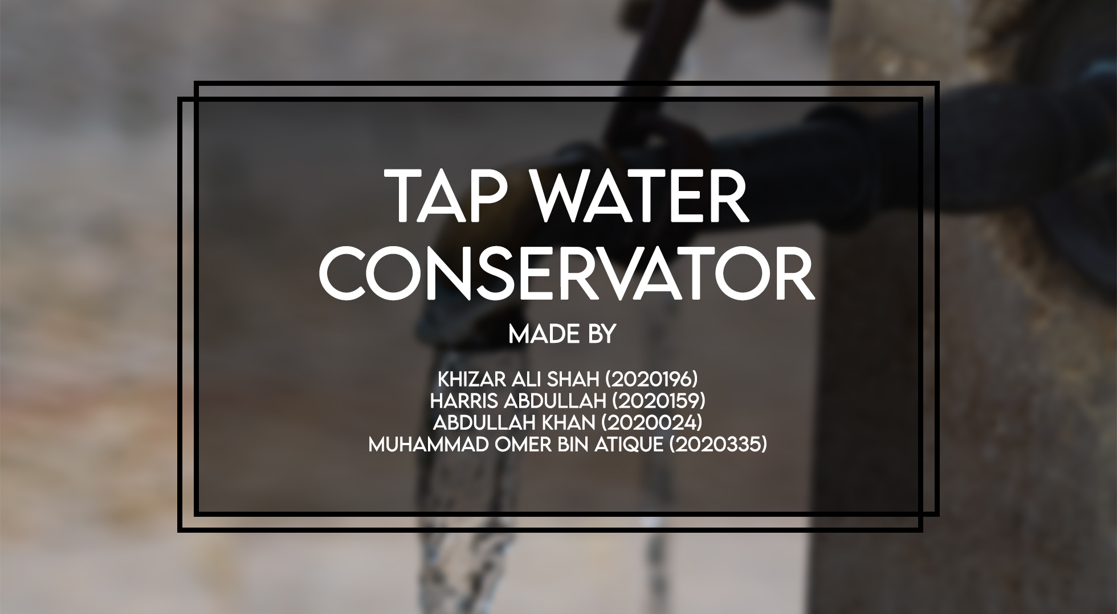

Slide 2
PROBLEM STATEMENT:
1) We all know that water is a precious resource that we have all taken for granted and waste in huge amounts everyday even without us realizing.
2) Our project allows us to mitigate this wastage in an effective yet cost efficient way.
3) Our project targets water wastage specifically from taps.
4) Our design utilizes concepts basic concepts that we have learned in DLD class.

Slide 3
COMPONENTS:
Ultrasonic Sensor
12 Volts Battery
2 AND Gates
1 NOT Gate
Servomotor
Astable 555 Timer
Resistor A (24k) and B (2.4k)
Capacitor (500uF)
4026 ICs(two)
Two 7-segment displays

Slide 4
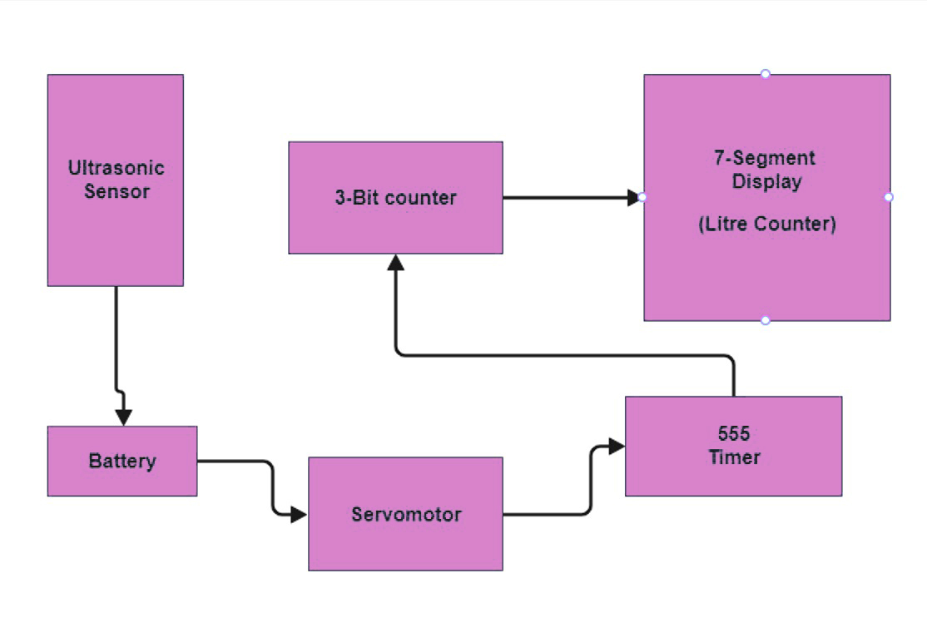
BLOCK DIAGRAM:

Slide 5
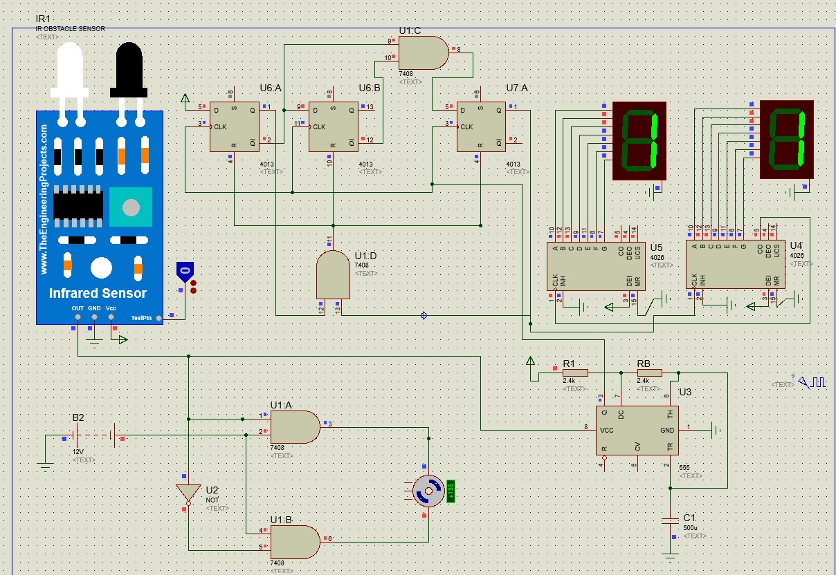
SIMULATION DIAGRAM:

Slide 6
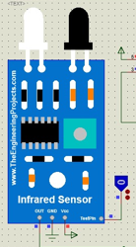
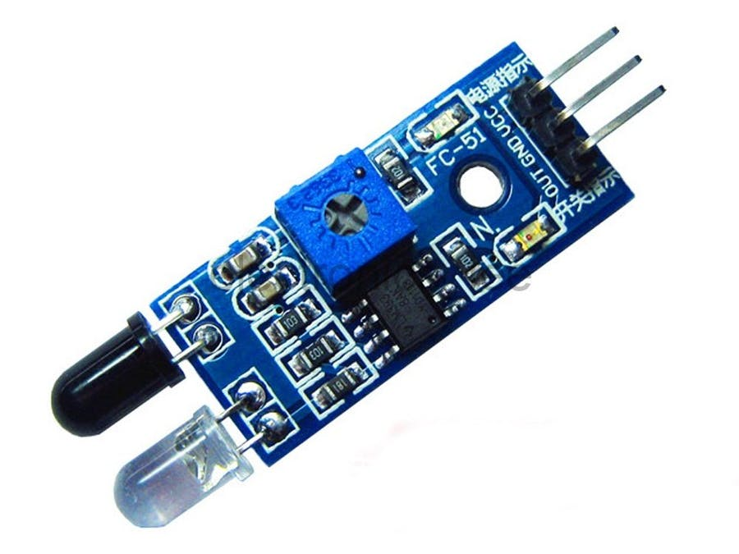
WORKING: IR SENSOR:

Slide 7
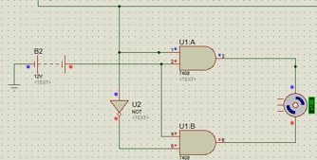
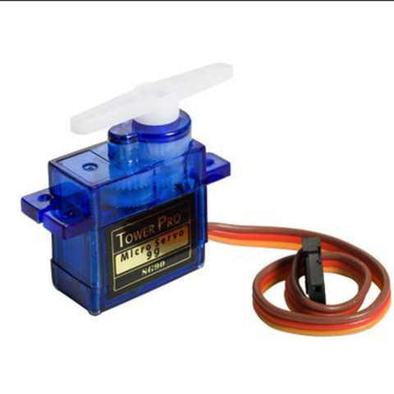
WORKING: SERVO MOTOR:

Slide 8
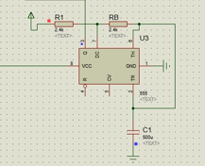
WORKING: ASTABLE 555 TIMER:

Slide 9
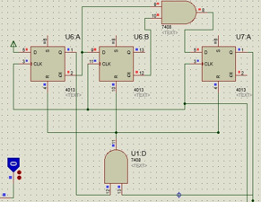
WORKING: 3-BIT SYNCHRONOUS UP COUNTER:

Slide 10
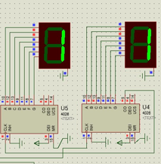
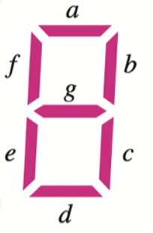
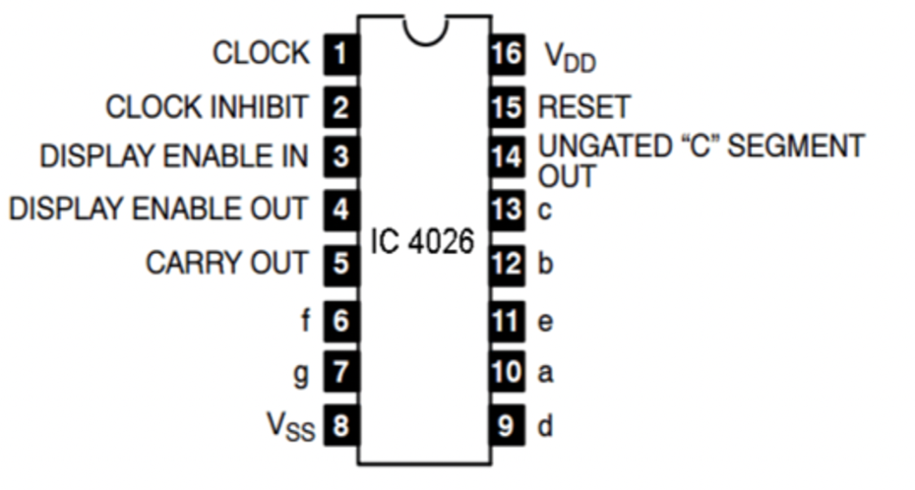
WORKING: 7-SEGMENT DISPLAY AND 4026 IC:

Slide 11
LIMITAIONS:
Current design works for only specific types of taps.
The sensor may detect other obstacles by mistake like the water from the tap
The counter is subject to our experimental calculations and the results may differ under different conditions

Slide 12
IMPROVEMENTS:
1) One possible improvement in the design is that we can have a servo motor on both taps.
2) We can also have a mechanism which will tell us the temperature of the water automatically.

